Slide 1
Civil Nuclear Roadmap: Overview
January 2024
Strategy & Insight Team
Contact: andrew.howarth@uknnl.com
Official - Commercial

Slide 2
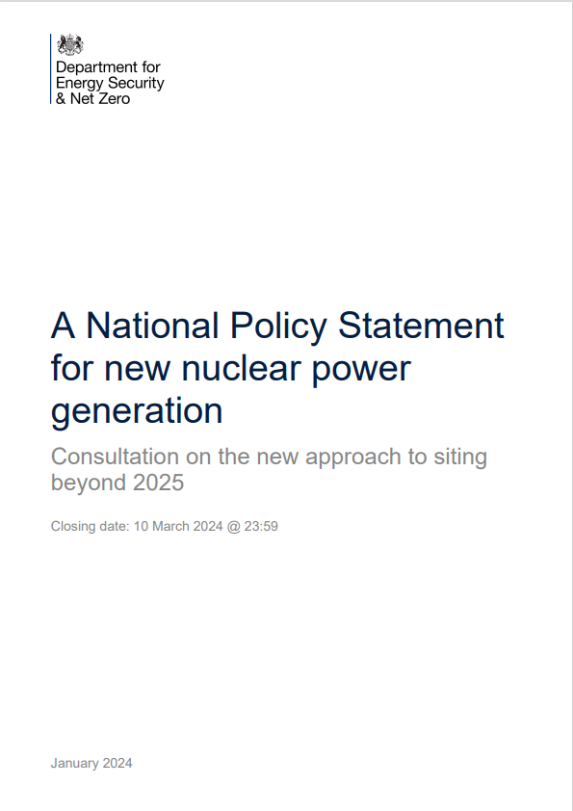
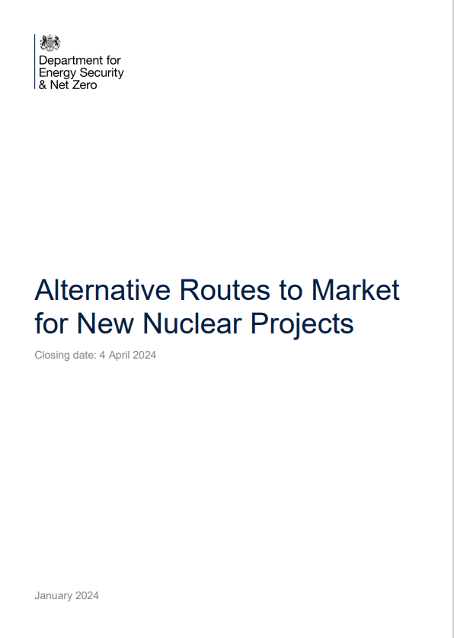
Introduction
On 11th January 2024 the government published a major new nuclear policy document, the “Civil Nuclear: Roadmap to 2050”, alongside two consultations on Siting Policy and Advanced Nuclear deployment.
The Roadmap was announced by the Energy Security Secretary Claire Coutinho whilst visiting NNL’s Preston laboratories
The following slides contain a summary of the major headlines and announcements from each document.
National Policy Statement for new nuclear power generation
Civil Nuclear: Roadmap to 2050
Alternative Routes to Market for New Nuclear Projects
Official - Commercial

Slide 3
Civil Nuclear: Roadmap to 2050
Official - Commercial

Slide 4
High level summary
Official - Commercial

Slide 5
Civil Nuclear: Roadmap to 2050 – Summary (1)
Why does it matter to NNL?
The Roadmap is a major policy document outlining the future direction of nuclear energy in the UK, and as such will heavily influence our own strategy.
NNL features throughout the document, with two specific case studies related to our specialist capabilities and our work in nuclear medicine.
We are named as a key partner organisation for delivering policies and have been awarded over £9m of new investment for research into HALEU fuel.
The Energy Secretary, Claire Coutinho, launched the Roadmap whilst at NNL’s Preston Laboratory
Summary and Headlines
The roadmap is a significant and forward-leaning document, reaffirming the UK government’s commitment to all forms of new nuclear. In addition to summarising the government and industry’s progress to date, it also sets out a series of new policies and funds:
Decisions on new projects: A written ambition to progress a third GW-scale reactor following a Final Investment Decision (FID) on Sizewell C this parliament, and to secure investment decisions to deliver 3-7GW of new nuclear every five years from 2030 to 2044
Siting: A new National Policy Statement, EN-7, is out for consultation. EN-7 sets out a criteria-based approach so that developers can nominate any suitable site for nuclear development, in addition to the finite list previously set out in EN-6. Following consultations, it is expected to be formally designated in 2025.
HALEU: As announced this week, a new fund of £300m to establish HALEU enrichment and routes to deconversion capabilities in the UK by the end of the decade. A further £9.35m has been awarded to NNL to create a Uranics Innovation Centre for the development of front-end fuels capabilities and for a concept design of a HALEU deconversion test facility
ANT: A consultation on Alternative Routes to Market for Advanced Nuclear Technology, looking to development government policy on how to most effectively deploy ANTs in the UK, covering the role of government, regulation, financial enablers and funding investment
Skills: Later this Spring publishing a Nuclear Skills Taskforce report alongside a Defence Nuclear Enterprise Command Paper, explaining how we will ensure our civil and military nuclear ambitions address our shared challenges and opportunities
Civil Nuclear: Roadmap to 2050
Official - Commercial

Slide 6
Civil Nuclear: Roadmap to 2050 – Summary (2)
Why does it matter to NNL?
The Roadmap is a major policy document outlining the future direction of nuclear energy in the UK, and as such will heavily influence our own strategy.
NNL features throughout the document, with two specific case studies related to our specialist capabilities and our work in nuclear medicine.
We are named as a key partner organisation for delivering policies and have been awarded over £9m of new investment for research into HALEU fuel.
The Energy Secretary, Claire Coutinho, launched the Roadmap whilst at NNL’s Preston Laboratory
Other announcements of interest to NNL include:
Health and Nuclear Medicine: Government is expected to take a decision on future intervention in supply, such as the need for radionuclide production technologies like a research reactor or accelerator, before March 2025. DESNZ will continue to work closely with the Welsh Government as their proposal for a research reactor in North Wales develops.
Clarity on the role of GBN - alongside delivery of the SMR programme, GBN will begin delivering other parts of government civil nuclear programme. GBN will also broaden out to a government advisory role, advising on new nuclear policy and strategy including programme delivery and design
Reprocessing and Pu reuse: Noting the government has no plans no plans to pursue, or provide financial support for, industrial scale reprocessing of spent nuclear fuel, and clarity that the UK will not support the use of plutonium stored at Sellafield by advanced nuclear technologies, whilst high hazard risk reduction activities are prioritised at site
UK waste policy: to publish in Spring a new UK wide policy that seeks to enable more sustainable and effective management of radioactive substances and nuclear decommissioning.
Civil Nuclear: Roadmap to 2050
Official - Commercial

Slide 7
Detailed assessment and what it means for NNL
Official - Commercial

Slide 8
Civil Nuclear: Roadmap to 2050 – Context
Why does it matter to NNL?
The Roadmap is a major policy document outlining the future direction of nuclear energy in the UK, and as such will heavily influence our own strategy.
NNL features throughout the document, with two specific case studies related to our specialist capabilities and our work in nuclear medicine.
We are named as a key partner organisation for delivering policies and have been awarded over £9m of new investment for research into HALEU fuel.
The Energy Secretary, Claire Coutinho, launched the Roadmap whilst at NNL’s Preston Laboratory
Context – why HMG has published a roadmap
The Roadmap sets out the pathway to a UK resurgence in civil nuclear, covering both the long-term strategy and the near-term enabling policies HMG is pursuing.
“The purpose of this Roadmap is to send an unambiguous signal to the nuclear sector and investors, setting out how we expect UK nuclear deployment to happen, a timeline for the key decisions and actions, and clarity over the role government and industry should play in supporting and enabling this delivery”
In addition to summarising the government and industry’s progress to date, it also sets out a series of new policies and commitments
What the Roadmap covers:
The pathway to 2050
The role of GBN
Siting and land usage
Regulating and streamlining the future of nuclear development
Financing and funding models
UK nuclear fuel cycle
Nuclear innovation and R&D
Decommissioning and taking care of our nuclear legacy – gearing up to dispose of waste from up to 24GW
The nuclear workforce of tomorrow
Developing the nuclear supply chain
In the following slides we summarise each of these areas and draw out any potential implications for NNL
Official - Commercial

Slide 9
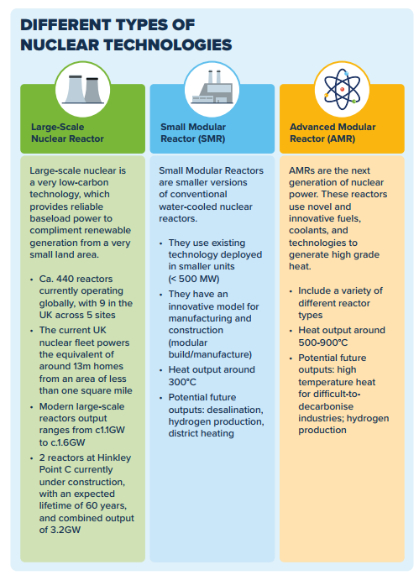
Civil Nuclear: Roadmap to 2050 – The pathway to 2050
Why does it matter to NNL?
It is valuable to have a forward look of decisions/milestones which could influence NNL’s activities.
For example, the forthcoming (spring) publications by the Nuclear Skills Taskforce and the Defence Nuclear Enterprise Command Paper relate to NNL’s role in providing strategic capabilities to support future civil and defence programmes.
The Roadmap reiterates that to deliver ambitions on nuclear capacity by 2050, we will need to go further across a wide spectrum of nuclear technologies – from SMRs to large-scale nuclear power stations and emerging AMRs.
This means providing the market with the confidence to make the right technological and supply chain investments.
The Roadmap sets out goals milestones for the next 12 months:
Launching consultations on Alternative Routes to Market for New Nuclear Projects and a new approach to siting nuclear within the National Policy Statement (NPS, EN-7) (with a consultation on the draft NPS to follow), that will further inform our civil nuclear policy (see later slides for more details)
Later this Spring publishing a Nuclear Skills Taskforce report alongside a Defence Nuclear Enterprise Command Paper, explaining how we will ensure our civil and military nuclear ambitions address our shared challenges and opportunities
Completing the GBN-led SMR technology selection process, announcing which technologies will be supported to achieve Final Investment Decision (FID) by 2029
Seeking to reach FID on Sizewell C (SZC) before the end of this Parliament
Monitoring the construction of Reactor Units 1 and 2 at Hinkley Point C (HPC) by EDF Energy so that our first new nuclear project in a generation can come online later this decade
Publishing a response to our consultation on nuclear decommissioning and managing radioactive substances, including radioactive waste
For longer-term clarity, the government is also now committing to:
Exploring a further large-scale reactor project and setting out timelines and processes this Parliament, subject to a SZC FID
Aiming to secure investment decisions to deliver 3-7GW every five years from 2030 to 2044, to meet our ambition to deploy up to 24GW of nuclear power by 2050.
Developing government policy to support investment in advanced nuclear technologies, following the Alternative Routes to Market consultation.
Official - Commercial

Slide 10
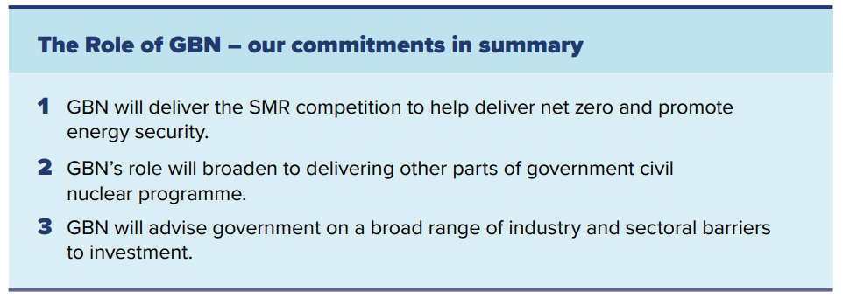
Civil Nuclear: Roadmap to 2050 – The role of Great British Nuclear
Why does it matter to NNL?
GBN is a relatively new organisation in the UK’s public sector nuclear enterprise, and it is in the process of establishing itself and its role
NNL’s relationship with GBN will be important; how we interact directly with GBN, with private sector vendors in the SMR competition, and in future how our policy and technical advice to HMG complements that of GBN (eg related to AMRs)
Government has committed to a programmatic approach to the delivery of new nuclear projects in Britain, giving industry and investors the confidence needed to deliver projects at pace and reducing costs through learning and replication. To deliver this, in spring 2023 GBN was launched, an arm’s-length body with the vital role of driving delivery of new nuclear projects on behalf of government.
Current focus: GBN’s initial priority is to run a competitive technical selection process to select the SMR technologies most likely to achieve a FID by 2029 and deliver operational projects in the mid-2030s,
GBN will access sites and establish delivery capability to bring projects forward. The chosen technologies will receive an unprecedented level of support: funding to support technology development and site-specific design; a close partnership with GBN, which will be ready and able to provide developer capability; and support in accessing sites.
Future focus: GBN will perform two key functions: a delivery and advisory role.
Delivery function - While SMRs represent the important next step in the nuclear programme, the government will work with GBN to consider how both large-scale and advanced nuclear technologies could contribute to UK energy security.
GBN’s advisory function As the government’s expert delivery body and given its technical, commercial and industry expertise, GBN will advise the government on new nuclear policy and strategy. This includes programme delivery and processes, and programme design and in the longer term on a broad range of industry and sectoral barriers to development.
Permanent recruitment is set to take place over the course of 2024, when GBN will also establish its permanent office presence to support its growth.
Official - Commercial

Slide 11
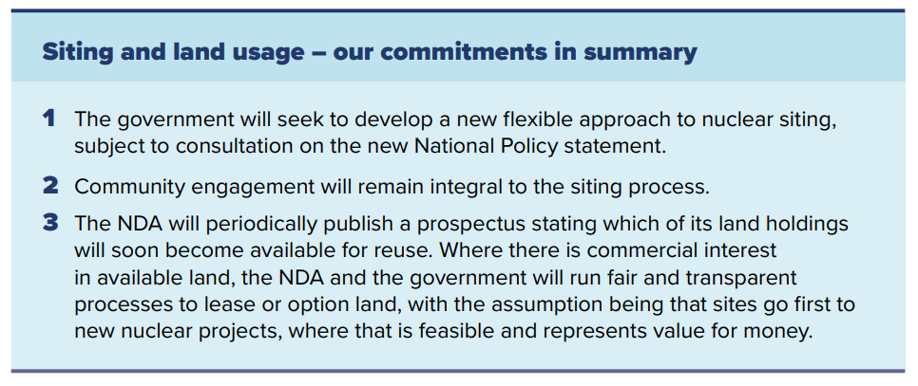
Civil Nuclear: Roadmap to 2050 – Siting and Land Usage
Why does it matter to NNL?
The new NPS will apply to any future deployment of advanced nuclear technologies, including the HTGR under development by NNL as part of the AMR RD&D competition
As the UK’s national laboratory for nuclear research, NNL will consider responding to the consultation.
The current nuclear National Policy Statement for new nuclear sites was designated in 2011 and focused on GW-scale nuclear developments. Now an NPS is required which can facilitate the rollout of SMRs and AMRs (alongside GW-scale projects), to meet our ambition for up to 24GW by 2050.
HMG recognises the potential advantages of the existing sites designated under EN-6 but also recognises the need for a greater diversity of sites and will seek to introduce a flexible approach to nuclear siting, subject to consultation on the new National Policy Statement (see later slides). This would set out clear criteria for future siting of new technologies and could open up opportunities to capitalise on the greater number of deployment scenarios and potential end-uses of different nuclear technologies.
Official - Commercial

Slide 12
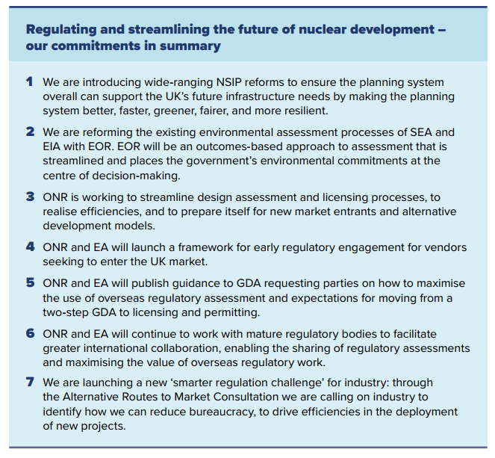
Civil Nuclear: Roadmap to 2050 – Regulating and streamlining the future of nuclear development
Why does it matter to NNL?
NNL has expertise across the regulation of nuclear safety, civil nuclear security and safeguards, and so needs to keep abreast of changes to the regulatory landscape
Phase C of the AMR RD&D programme, should it proceed, is to take the UKJ-HTR design through GDA to commissioning, and changes to/streamlining of the regulatory process will need to be factored into future plans
NNL may choose to respond to the Alternative Routes to Market Consultation questions related to regulating advanced nuclear
The Roadmap sets out opportunities for flexibility and optimisation in regulation, potentially reducing the timescales for completion of a Generic Design Assessment (GDA) by up to 50%, while maintaining the highest safety and security standards and environmental protection.
It does this through outlining recent and ongoing initiatives being undertaken by the regulators to streamline regulatory processes, and sets out future commitments (see box)
A major new commitment is the launch of the new ‘smarter regulation challenge’ for industry through the Alternative Routes to Market Consultation (see later slides). HMG is calling on industry to identify how we can reduce bureaucracy to drive efficiencies in the deployment of new projects.
Official - Commercial

Slide 13
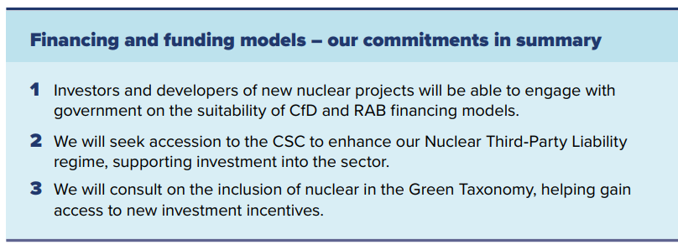
Civil Nuclear: Roadmap to 2050 – Financing and funding models
Why does it matter to NNL?
Knowledge of possible financing structures for new nuclear projects can help inform ongoing work under AMR RD&D Phase B, which will set out plans for Phase C and a subsequent fleet, each of which will need a structured approach to financing
NNL may wish to respond to the future consultation on inclusion of nuclear in the Green Taxonomy – we previously supported initiatives for the equivalent EU taxonomy
The Roadmap sets out the financing mechanisms and measures the government has put in place to ensure that new nuclear projects can be effectively financed.
It confirms that both the CfD and RAB funding models will be available as possible approaches for future nuclear projects.
The government is also taking further steps to make UK nuclear projects investable. This includes enhancing the UK’s Nuclear Third-Party Liability (NTPL) regime, as well as consulting on including nuclear in the UK’s Green Taxonomy.
Official - Commercial

Slide 14
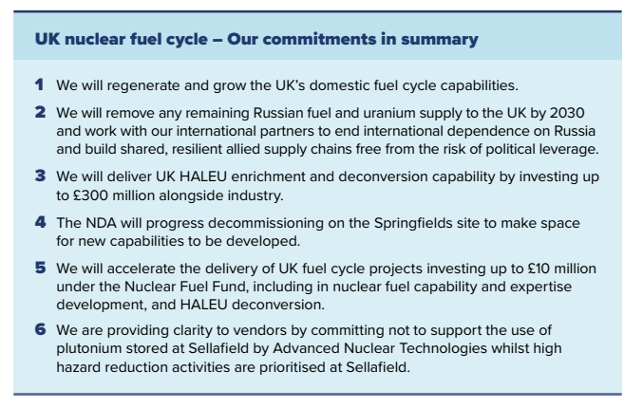
Civil Nuclear: Roadmap to 2050 – UK nuclear fuel cycle
Why does it matter to NNL?
Securing a UK supply of domestic fuel, and associated capabilities, is a headline policy in the Roadmap, with significant new funding (£300m) announced.
NNL’s capabilities are referenced as having a key role to play, leading on underpinning R&D and provision of technical advice related to development of advanced fuels
The decision not to support use of plutonium for ANTs may have implications for AMR vendors and where NNL provides advice and technical support
The Roadmap emphasises the importance of fuel cycle capabilities to underpin government net zero and national security objectives, and that interventions are required to ‘regenerate’ our world leading fuel cycle capabilities and capacity for LEU, LEU+ and HALEU fuels. Government reiterates existing initiatives through the Nuclear Fuel Fund and AMR RD&D programme, and a significant new package of funding and policy commitments:
up to £300m in a UK HALEU Fuels Programme through the Green Industries Growth Accelerator Fund to establish HALEU enrichment and routes to deconversion capabilities by the end of the decade.
Under the NFF, DESNZ will also be investing:
up to £6m in a Uranics Innovation Centre at the National Nuclear Laboratory (NNL) in partnership with UK universities, to support the development of front end fuels capabilities and expertise in the UK.
up to £3.35m in the NNL to undertake a concept design of a HALEU deconversion test facility, in support of building domestic capability to support a UK HALEU programme.
up to £800,000 in a siting study for the location of potential new nuclear fuel production facilities in the UK.
Microreactors: DESNZ are also supporting advanced uranium fuel development for micro-reactors, which, in addition to civil terrestrial applications, could be used for defence and extraterrestrial applications in the future
Plutonium fuels: HMG states for the first time that the UK will not support the use of plutonium stored at Sellafield by advanced nuclear technologies, whilst high hazard risk reduction activities are prioritised at site
Official - Commercial

Slide 15
Civil Nuclear: Roadmap to 2050 – Nuclear innovation and R&D
Why does it matter to NNL?
NNL’s role as national lab and our unique capabilities are central to this section, with NNL featuring in two case studies.
The strategic review of NNL, presently being undertaken by DESNZ, is mentioned – this aims to reaffirm NNL’s role in underpinning civil and defence nuclear programmes, and the capabilities NNL needs to perform this role.
Policy decisions related to a UK supply of nuclear medicine will influence NNL’s Health and Nuclear Medicine focus area strategy
The Roadmap states the UK also requires a set of critical supporting capabilities, such as capabilities in analytics, materials handling, waste and spent fuel management, and research facilities to underpin our fuel cycle ambitions.
NNL is referenced as central to the UK’s nuclear infrastructure, part of “a network of national laboratories, including National Physical Laboratory “ alongside NDA and NWS as institutions essential to safe operation of our nuclear fleets, and sustaining critical civil and defence programmes. Our capabilities feature as a case study (next slide).
The roadmap outlines where DESNZ is investing in technology development - NNL is involved in all initiatives:
AMR demonstrator programme – NNL leading UKJ-HTR development in AMR RD&D Phase B
Access to irradiation facilities – NEA FIDES-II, which NNL coordinates on behalf of the UK
Medical radionuclide supply – Government is expected to take a decision on future intervention in supply, such as the need for radionuclide production technologies like a research reactor or accelerator, before March 2025. DESNZ will continue to work closely with the Welsh Government as their proposal for a research reactor in North Wales develops. NNL’s work in nuclear medicine features as a case study (next slide)
Extraterrestrial Nuclear Applications – NNL’s work in Americium extraction, with £19m investment in PuMA 2 at Central Lab
Official - Commercial

Slide 16
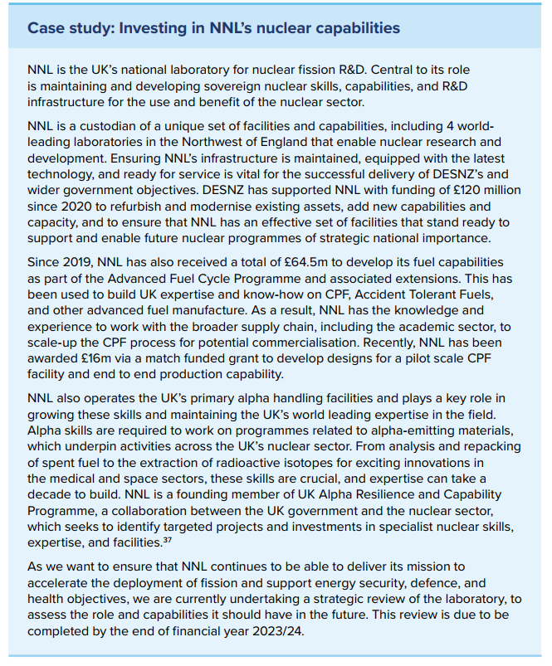
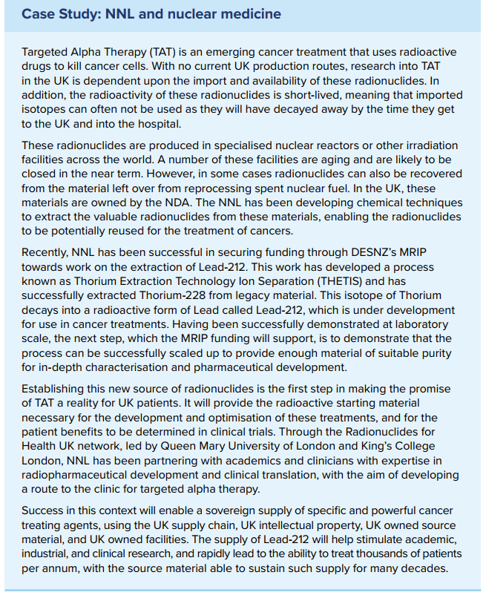
Civil Nuclear: Roadmap to 2050 - Nuclear innovation and R&D (2)
Why does it matter to NNL?
This section significantly raises the profile of NNL as a vital part of the UK’s nuclear ecosystem, reflecting how our relationship with our sponsor department has matured over recent years.
Our purpose of ‘nuclear science to benefit society’ has enabled us to set our strategy to align closely with Government priorities, and in several areas to positively influence policy.
UK nuclear fuel cycle – deeper dive
NNL features in two case study boxes, covering the CAMILA infrastructure investment programme, and on NNL’s research into Lead-212 under the Health & Nuclear Medicine focus area:
Official - Commercial

Slide 17
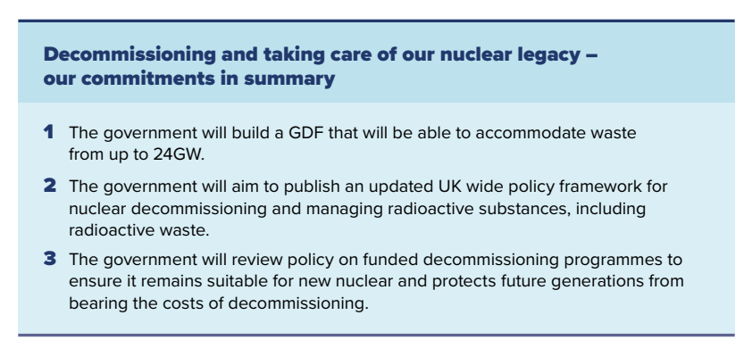
Civil Nuclear: Roadmap to 2050 – Decommissioning and taking care of our nuclear legacy – gearing up to dispose of waste from up to 24GW
Why does it matter to NNL?
A significant proportion of NNL’s activities relates to waste management and decommissioning and so we need to be aware of policy developments
NNL has in recent years, through HMG and NNL internal funding, maintained a UK capability in advanced recycle to be able to support future decisions related to closing the fuel cycle.
The Roadmap sets out how HMG is reviewing current policy related to waste management and decommissioning to be fit for past, present and future needs. It commits to “publish in spring 2024 a new UK wide policy that seeks to enable more sustainable and effective management of radioactive substances and nuclear decommissioning”
Reprocessing: the roadmap is clear that since the UK has ceased industrial scale reprocessing, the government has not received any credible proposals from industry to restart reprocessing and has no plans to pursue, or provide financial support for, industrial scale reprocessing of spent nuclear fuel.
In the absence of reprocessing proposals from industry, owners of spent fuel, including from new or advanced reactors, should proceed on the basis that spent fuel will not be reprocessed and waste management plans, including financing, should reflect this
Official - Commercial

Slide 18
Civil Nuclear: Roadmap to 2050 – The nuclear workforce of tomorrow
Why does it matter to NNL?
Part of NNL’s role is to develop a pipeline of individuals with high level nuclear skills into the sector, including Subject Matter Experts.
We are involved with the Nuclear Skills Strategy Group and the Nuclear Skills Taskforce, and have provided input into the forthcoming taskforce proposals
The Roadmap highlights the challenge facing the nuclear sector to increase the number of people working in the civil and defence nuclear sectors from around 83,000 people to between around 150,000 to 180,000 by 2043 in a 24GW scenario, dependent upon the level of defence activity.
A combination of existing and new groups are exploring ways to address the skills challenge including the Nuclear Skills Strategy Group and the newly formed Nuclear Skills Taskforce.
The Taskforce is due to publish its recommendations in early 2024, setting out the action that the UK nuclear sector can take to ensure we have sufficient and appropriate nuclear skills to deliver our nuclear ambitions. It will champion the roles of government, industry, and academia as part of collaborative action in response to achieving a shared goal. The Roadmap lists areas where its proposals will focus, including high level nuclear skills:
“Fostering specialised scientific nuclear skills to support the technical delivery of new build programmes, including through increased opportunities for PhD students. “
Official - Commercial

Slide 19
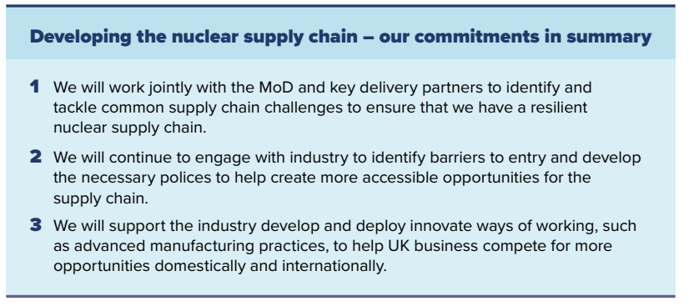
Civil Nuclear: Roadmap to 2050 – Developing the nuclear supply chain
Why does it matter to NNL?
NNL has its own role to play in supporting the nuclear supply chain, particularly in supporting SMEs to enter the nuclear sector.
The roadmap notes the opportunity for international supply chain collaboration, including with Japan. Delivering a UKJ-HTR demonstrator will hinge on successfully coordinating the UK and Japanese supply chains.
The Roadmap sets out the steps government is taking to ensure a robust supply chain, that can support both the civil and nuclear defence sectors.
DESNZ and MoD have established a formal Nuclear Supply Chain Working Group for government and its delivery partners to tackle shared challenges and identify further opportunities to collaborate.
As GBN develops its advisory role, the government intends to use the organisation’s expertise to identify additional supply chain barriers and gaps in the existing policy to help inform future policy development.
The NDA will look to create a decommissioning standards database to standardise common engineering designs used by the nuclear industry. The initial database is expected to launch in April 2024.
Official - Commercial

Slide 20
Civil Nuclear: Roadmap to 2050 – Delivering the Roadmap
Why does it matter to NNL?
NNL is stated as a key partner organisation in delivering policies
NNL has been a member of previous incarnations of the Nuclear Industry Council and its sub-groups, and is likely to be included in its reconstituted membership
Whilst this Roadmap sets out commitments for the civil nuclear sector, alignment with MOD and its defence programmes is a wider HMG policy ambition – NNL spans both sectors and will play a vital role in supporting future programmes.
The final chapter of the Roadmap sets out how Government will deliver and monitor progress against its commitments.
It states
“Our partner organisations, GBN, NNL and the NDA, are key to delivering our policies.”
DESNZ will continue to work jointly with MoD to seek alignment across civil and defence
A significant new announcement is the intention for DESNZ to work with MOD to reconstitute the Nuclear Industry Council to provide strategic direction to the nuclear sector, including overseeing the delivery of a programme of work aligned to key commitments set out in the Roadmap.
Official - Commercial

Slide 21
Alternative Routes to Market for New Nuclear Projects
Consultation

Slide 22
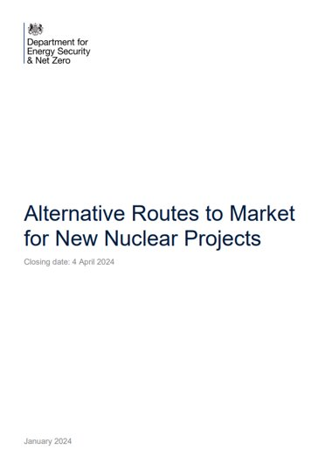
Alternative Routes to Market
Why does it matter to NNL?
NNL is directly involved in the deployment of Advanced Nuclear Technology via our role in the AMR RD&D competition, developing a High Temperature Gas Reactor suitable for the UK. We also provide support to vendors of other ANTs with interest in developing and deploying their technologies in the UK.
As the UK’s national laboratory for nuclear research, NNL will consider responding to the consultation
Consultation on Alternative Routes to Market for New Nuclear Projects
Alongside the Civil Nuclear Roadmap, DESNZ has launched a three-month consultation to explore what steps the government can take to enable efficient deployment of Advanced Nuclear Technologies (ANTs), and to also explore the uses for ANTs and potential benefits that they can provide to the UK economy.
DESNZ is seeking views on (further detail is given on the following slides):
Exploring New Uses: The potential use cases, beyond electricity, for ANTs what they could bring to the UK energy landscape. HMG is seeking views on the potential role for government in enabling these new use cases.
Regulating Advanced Nuclear: Evaluates the appropriateness of the current regulatory pathway for ANTs and details new options for early engagement between the nuclear industry and the regulators. It also considers the vital roles that security, safeguards, and waste management play in the nuclear sector.
Bringing projects to market: Discusses how HMG can support private developers and help them bring projects forward to complement the work being undertaken by Great British Nuclear (GBN). HMG are keen to hear from developers about what government can do to support investment and enable routes to market for ANTs.
Supporting future technology: Sets out the funding support that HMG currently provides for innovation in the sector and seeks views on how government can further support R&D in the sector.
Alternative Routes to Market for New Nuclear Projects (publishing.service.gov.uk)
The consultation closes on 04 April 2024
Official - Commercial

Slide 23
Alternative Routes to Market - Potential new uses cases of nuclear
Why does it matter to NNL?
NNL is directly involved in the deployment of Advanced Nuclear Technology via our role in the AMR RD&D competition, developing a High Temperature Gas Reactor suitable for the UK. We also provide support to vendors of other ANTs with interest in developing and deploying their technologies in the UK.
As the UK’s national laboratory for nuclear research, NNL will consider responding to the consultation.
Chapter 1 - Potential new uses cases of nuclear
Flexible electricity generation: on-grid power servicing a different system purpose to traditional baseload nuclear by altering power output in response to demand.
Industrial heat and power: heat and power to industrial consumers to support existing and new manufacturing and processing sectors, such as chemicals, pulp and paper, food and drink or data centres.
Hydrogen and synthetic fuels: nuclear energy for industry could also help produce other energy products such as hydrogen, ammonia, and synthetic fuels.
District heating: supply of heat to buildings via local heat networks.
Other proposed uses: additional uses could include transportable heat and power, civil marine propulsion, or reusing legacy nuclear materials.
DESNZ is seeking responses to the following questions
Alternative Routes to Market for New Nuclear Projects (publishing.service.gov.uk)
Official - Commercial

Slide 24
Alternative Routes to Market - Regulating Advanced Nuclear
Why does it matter to NNL?
NNL is directly involved in the deployment of Advanced Nuclear Technology via our role in the AMR RD&D competition, developing a High Temperature Gas Reactor suitable for the UK. We also provide support to vendors of other ANTs with interest in developing and deploying their technologies in the UK.
As the UK’s national laboratory for nuclear research, NNL will consider responding to the consultation.
Chapter 2 - Regulating Advanced Nuclear
This section seeks views on the applicability of current regulatory framework to deployment of current and advanced nuclear technologies. It outlines:
Our current regulatory framework
Regulatory pathways
Applicability to advanced nuclear
Planning and smarter regulation
Legislation
Early engagement with the regulators
Securing safe nuclear operations
DESNZ is seeking responses to the following questions
Alternative Routes to Market for New Nuclear Projects (publishing.service.gov.uk)
Official - Commercial

Slide 25
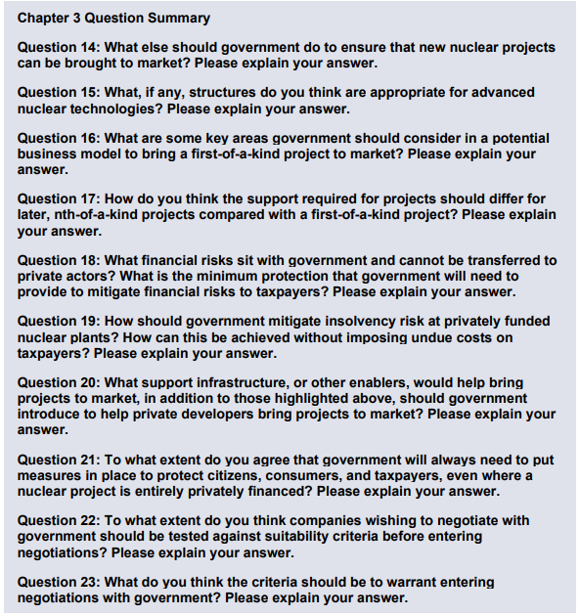
Alternative Routes to Market - Bringing Projects to Market
Why does it matter to NNL?
NNL is directly involved in the deployment of Advanced Nuclear Technology via our role in the AMR RD&D competition, developing a High Temperature Gas Reactor suitable for the UK. We also provide support to vendors of other ANTs with interest in developing and deploying their technologies in the UK.
As the UK’s national laboratory for nuclear research, NNL will consider responding to the consultation.
Chapter 3 - Bringing Projects to Market
DESNZ are seeking views on what the market can deliver in relation to the key building blocks of a nuclear project (for instance developer capability), and what further policy action could be put in place to support commercial deployment of ANTs. They are also interested in market views on the role of GBN in relation to the development of ANTs - beyond their existing role driving the SMR Programme.
Emphasis is on investment challenges and the effectiveness of mechanisms government has already introduced to support nuclear investment.
DESNZ is seeking responses to the following questions
Alternative Routes to Market for New Nuclear Projects (publishing.service.gov.uk)
Official - Commercial

Slide 26
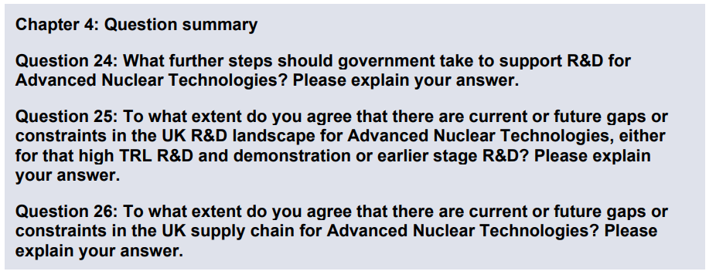
Alternative Routes to Market - Supporting Future Technology
Why does it matter to NNL?
NNL is directly involved in the deployment of Advanced Nuclear Technology via our role in the AMR RD&D competition, developing a High Temperature Gas Reactor suitable for the UK. We also provide support to vendors of other ANTs with interest in developing and deploying their technologies in the UK.
As the UK’s national laboratory for nuclear research, NNL will consider responding to the consultation.
Chapter 4 - Supporting Future Technology
This chapter outlines existing initiatives HMG has put in place to support R&D related to AMRs and SMRs., and is seeking views on the level of current support, and also on the research infrastructure and supply chain needed for future technology development.
It reiterates support for HTGRs and CPF via the AMR RD&D programme, however is also keen to state “government continues to support the development of the full spectrum of ANTs and welcomes private sector R&D in other technology types.”
It also clearly states in relation to the AMR RD&D programme that “If a private/commercial entity could provide a solution that met the Programme aims, objectives, and market needs, then future phases would no longer be necessary”
As the ANT sector grows, government anticipates that there will be an increase in demand for the advanced nuclear supply chain. It acknowledges the UK already has a wide range of nuclear R&D facilities held by the National Nuclear Laboratory and other Public Sector Research Establishments, academia and the private sector.
DESNZ is seeking responses to the following questions
Alternative Routes to Market for New Nuclear Projects (publishing.service.gov.uk)
Official - Commercial

Slide 27
National Policy Statement for new nuclear power generation
Consultation

Slide 28
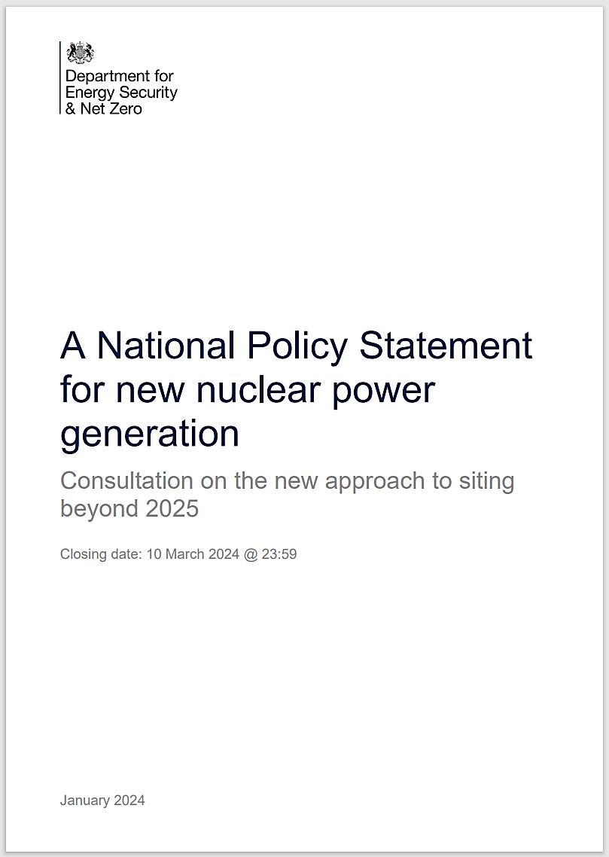
NPS: Siting New Nuclear Stations Beyond 2025
Why does it matter to NNL?
The new NPS will apply to any future deployment of advanced nuclear technologies, including the HTGR under development by NNL as part of the AMR RD&D competition
As the UK’s national laboratory for nuclear research, NNL will consider responding.
Consultation on nuclear siting
This consultation is the first step in designating a new Nuclear National Policy Statement (NPS), EN-7, applicable to nuclear power stations expected to deploy after 2025, covering GW-scale, SMRs and AMRs. The approach sets out a much more flexible and future-proof approach to siting new nuclear.
This consultation focuses on the overall policy approach, and will be followed by a further formal consultation on the exact wording of the National Policy Statement.
Key policy proposals include:
A criteria-based approach to new nuclear deployment, with updated criteria that constrain where development can occur. Therefore, identification of specific sites for deployment is no longer needed, and developer can suggest any appropriate site.
Broadening the scope of EN-7 to apply to both GW scale nuclear projects (>1000 MW) and to SMRs/AMRs, which typically have a generation capacity <500 MW. Inclusion of SMRs marks a key change from EN-6. The government also intends to broaden the scope of the NSIP definition to include heat-only and synthetic fuel-only reactors.
The key difference between the current nuclear NPS, EN-6 and the criteria-based approach under EN-7 is a shift from government to the developer in undertaking the site assessment. Under EN-7 the developer will be responsible for site characterisation and ensuring any potential site meets the criteria set out in the NPS for the deployment of their chosen technology.
The removal of the deployment time limit for new projects to enable more siting opportunities and facilitate longer term market development.
It is noted that research reactors with a generating output of less than 50MW in England and reactors that are solely used to produce medical radioisotopes would ordinarily continue to be consented through the local planning route.
EN-7 is solely focused on nuclear fission. The Government has committed to producing a separate NPS for fusion energy due to the differences in technology.
Approach to siting new nuclear power stations beyond 2025 - GOV.UK (www.gov.uk)
The consultation closes on 10 March 2024
Official - Commercial

Slide 29
Thank you
Strategy & Insight Team
Contact: andrew.howarth@uknnl.com
Official - Commercial

